Slide 1
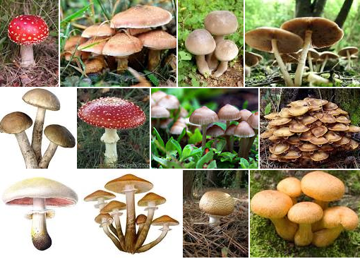
CLASSIFICATION OF MUSHROOMS
INSY-5339
GROUP-06
Aditya Kashyap
Madhuri Murali
Maheema Gajaraj
Revathi Meenakshi Nachadalingam

Slide 2
INTRODUCTION:
Mushroom is the fruiting body of a fungus, typically grown on soil.
Mushrooms are extensively used in many cuisines.
They are known as the “meat” of the vegetable world.
However only a small portion of them are edible.
It is really dangerous to eat a poisonous mushroom.

Slide 3
OBJECTIVE
To predict if the mushrooms in the given data set are edible or poisonous using various classification algorithms.
To compare the classifiers used and to understand how they work
To implement 4 classification algorithms to build models for prediction and learn their accuracies in the classification process.

Slide 4
INFORMATION ABOUT THE DATA SET
We have extracted our dataset from UCI Machine Learning Repository.
This data set has records from Audubon Society Field Guide to North American Mushrooms.
DATA SET CHARACTERISTICS | Multivariate | NUMBER OF INSTANCES | 8416
ATTRIBUTE CHARACTERISTICS | Categorical | NUMBER OF ATTRIBUTES | 22
ASSOCIATED TASKS | Classification | MISSING VALUES | YES

Slide 5
INFORMATION ABOUT THE DATA SET contd..
The original data set consisted of a set of 8416 instances with 22 attributes and a class label, poisonous or edible.
All of the attribute values were nominal.
Multiple feature descriptions of one species of mushroom were possible because one species might be found in several different habitats, have more than one possible odor, have different ring types etc.

Slide 6
DATA DISTRIBUTION
ATTRIBUTES | DESCRIPTION | DATA TYPE
Cap Shape | The shape of the mushroom’s cap portion | Nominal
Cap Color | The color of the mushroom’s cap portion | Nominal
Bruises | Change in mushroom’s color when damaged | Binominal
Odor | Odor emanating from the mushroom | Nominal
Gill Spacing | How close or far apart the gills are spaced | Nominal
Gill Size | The size of each gill | Binomial
Gill Color | The color of the gills | Nominal
Stalk Surface Above Ring | Nature of the surface of the stalk above the ring | Nominal
Habitat | The environment in which the mushroom grows | Nominal
Population | Population density of the mushrooms | Nominal

Slide 7
Cont..
ATTRIBUTES | DESCRIPTION | DATA TYPE
Stalk Surface Below Ring | Nature of the surface of the stalk above the ring | Nominal
Stalk Color Below Ring | Color of the surface of the stalk above the ring | Nominal
Stalk Color Below Ring | Color of the surface of the stalk above the ring | Nominal
Ring Number | Number of rings present in the mushroom | Nominal
Ring Type | Shape of the ring present in the mushroom | Nominal
Spore Print Color | Color of the mushroom’s spores | Nominal
Edibility | Indicates whether the mushroom is edible or poisonous | Binominal

Slide 8
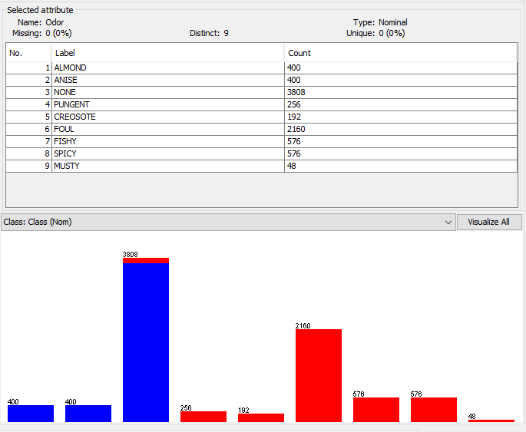
IMPORTANT ATTRIBUTES BASED ON BESTFIRST
Odour
Gill-Spacing
Stalk-surface-above-ring

Slide 9
DATA CLEANING
Data cleaning is the process of removing incomplete, noisy and inconsistent data.
incomplete: lacking attribute values, lacking certain attributes of interest, or containing only aggregate data
noisy: containing errors or outliers
inconsistent: containing discrepancies in codes or names
The Mushroom dataset was not a completely clean dataset.

Slide 10
DATA CLEANING cont.…
The attribute ‘stalk-root’ was removed because it had many missing values.
The important attributes were identified based on ‘best first’ and information gain.
Six attributes with the least information gain were removed.
This cleaning process was done using Weka and Microsoft Excel 2013.

Slide 11
DATA CLEANING cont.…
The following attributes were found to have very low information gain using Weka , and thus were removed during the cleaning process
Gill attachment
Veil type
Cap surface
Stalk shape
Stalk root
Veil color

Slide 12
PRE-PROCESSING STEPS
The following factors were applied to the dataset:
Noise : 0%, 10%, 25%.
Attributes: All attributes, ‘odor’ attribute removed.

Slide 13
FACTOR DESIGN
NOISE
ATTRIBUTES |  | 0% | 10% | 25%
 | All attributes | E1 (0% noise, all attributes) | E2(10% noise, all attributes) | E3(25% noise, all attributes)
 | ‘Odor’ attribute removed | E4(0% noise, ‘odor’ attribute removed) | E5(10% noise, ‘odor’ attribute removed) | E6(25%, ‘odor’ attribute removed)

Slide 14
ALGORITHMS
One R
Naïve Bayes
J48
Voted Perceptron

Slide 15
ONE R
OneR, short for "One Rule", is a classification algorithm that generates one rule for each predictor in the data, then selects the rule with the smallest total error as its "one rule".
To create a rule for a predictor, it constructs a frequency table for each predictor against the target.
Predictors Contribution
Total error calculated from the frequency tables is the measure of each predictor contribution. A low total error means a higher contribution to the predictability of the model.

Slide 16
Naïve Bayes classifier
Naive Bayes classifiers are a family of simple probabilistic classifier
It is based on applying Bayes Theorem with strong independence assumptions between the features.
Common principle: Naive Bayes classifiers assume that the value of a particular feature is independent of the value of any other feature, given the class variable.
Works quite well in many complex real-world situations.

Slide 17
J48
J48 implements Quinlan’s C4.5 algorithm to generate pruned or unpruned C4.5 decision tree, used for classification.
Builds decision trees from a set of labeled training data using the concept of information entropy.
Where p( j | t) is the relative frequency of class j at node t
Handles both continuous and discrete attributes, training data with missing attribute values and attributes with differing costs. Further it provides an option for pruning trees after creation.

Slide 18
Advantages of J48
Easy to understand by the end user
Able to process erroneous datasets or missing values
High performance Accuracy
Disadvantages of J48
Size of the tree increases linearly with the number of examples
Space complexity
Tree replication

Slide 19
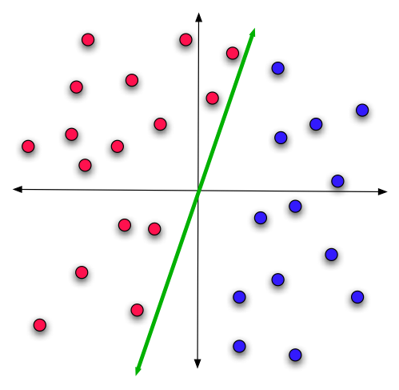
Simple perceptron
Perceptron Learning
You can prove that
If it’s possible to separate the data with a hyperplane (i.e. if it’s linearly separable),
Then the algorithm will converge to that hyperplane.
Linear classification

Slide 20
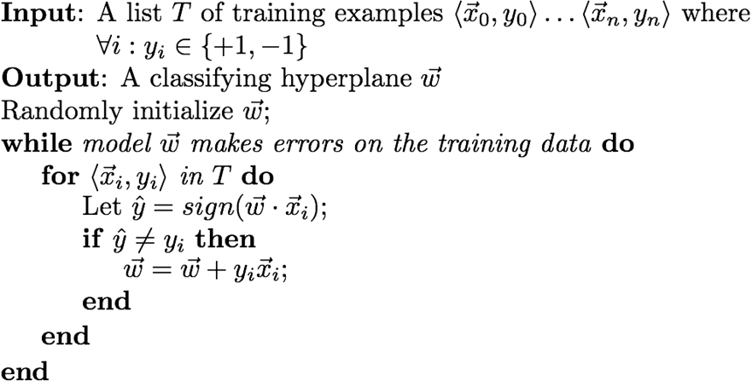
Perceptron Learning Algorithm

Slide 21
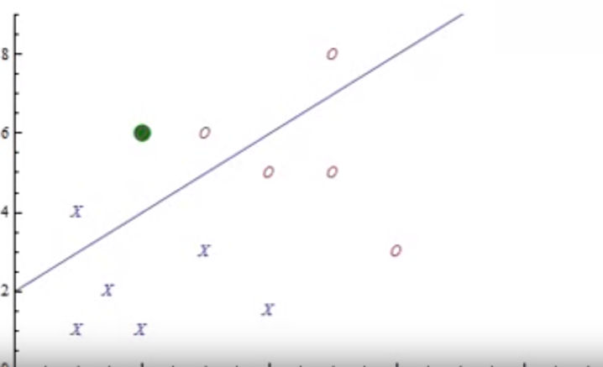
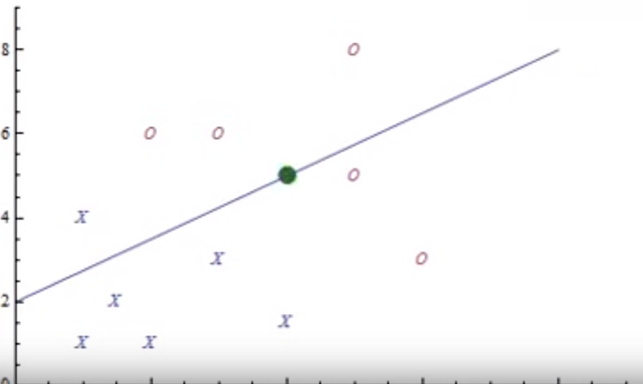
Working with an example.

Slide 22
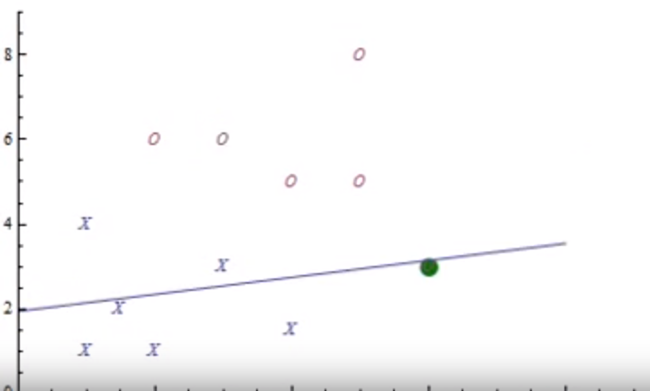
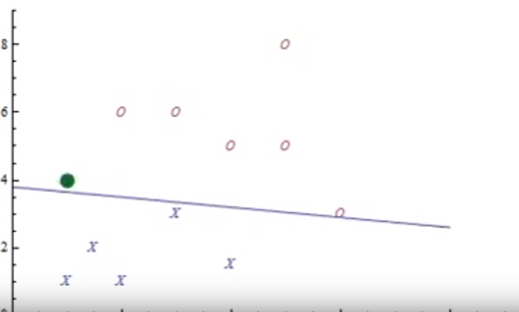

Slide 23
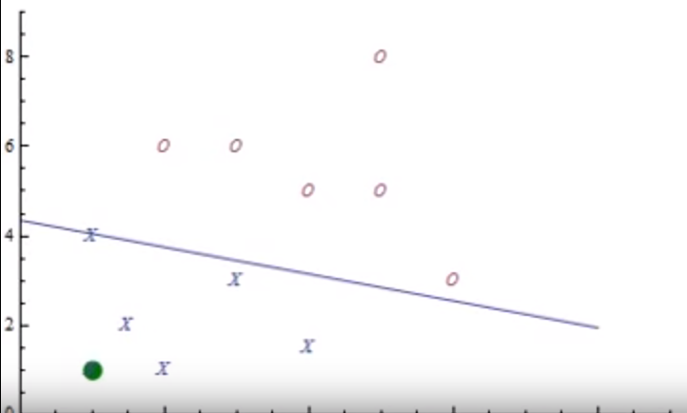
Resulting Line

Slide 24
Voted Perceptron
Works just like a regular perceptron, except you keep track of all the intermediate models you created
When you want to classify something, you let each of the (many, many) models vote on the answer and take the majority.
Properties
Much better generalization performance than regular perceptron
Training as fast as regular perceptron
But run-time is slower

Slide 25


OUTPUT

Slide 26
Comparison Of Results obtained by Algorithms
ALGORITHM NAME |  | OneR
Expt No. | Type | Correctly | Correctly% | Incorrectly | Incorrectly% | Total Num | Variance
E1 | All Default | 2817.4 | 98.48% | 43.6 | 1.52% | 2861 | 0.020687
E2 | 10%noise | 2544.5 | 88.94% | 316.5 | 11.06% | 2861 | 0.048936
E3 | 25%noise | 2123.8 | 74.23% | 737.2 | 25.77% | 2861 | 0.566
E4 | NoOdor | 2489.9 | 87.03% | 371.1 | 12.97% | 2861 | 0.246091
E5 | 10%NoOdor | 2282.2 | 79.77% | 578.8 | 20.23% | 2861 | 0.21415
E6 | 25%NoOdor | 1968.9 | 68.82% | 892.1 | 31.18% | 2861 | 0.325637
ALGORITHM NAME |  | Naïve Bayes
Expt No. | Type | Correctly | Correctly % | Incorrectly | Incorrectly % | Total Num | Variance
E1 | All Default | 2746.2 | 95.98741 | 114.8 | 4.01259 | 2861 | 0.251058
E2 | 10%noise | 2406.2 | 84.00346 | 454.8 | 15.89654 | 2861 | 0.3803
E3 | 25%noise | 2030.1 | 70.95771 | 830.9 | 29.04229 | 2861 | 0.533313
E4 | NoOdor | 2564.7 | 89.64347 | 296.3 | 10.35653 | 2861 | 0.317386
E5 | 10%NoOdor | 2334.5 | 81.59734 | 526.5 | 18.40266 | 2861 | 0.178981
E6 | 25%NoOdor | 1995.8 | 69.75883 | 865.2 | 30.24117 | 2861 | 0.335796

Slide 27
Comparison Of Results obtained by Algorithms cont.…
ALGORITHM NAME |  | J48
Expt No. | Type | Correctly | Correctly % | Incorrectly | Incorrectly % | Total Num | Variance
E1 | All Default | 2861 | 100 | 0 | 0 | 2861 | 0
E2 | 10%noise | 2580.3 | 90.18874 | 280.7 | 9.81126 | 2861 | 0.042634
E3 | 25%noise | 2144.1 | 74.94233 | 716.9 | 25.05767 | 2861 | 0.672878
E4 | NoOdor | 2859 | 99.93009 | 2 | 0.06991 | 2861 | 0.011132
E5 | 10%NoOdor | 2580.3 | 90.18874 | 280.7 | 9.81126 | 2861 | 0.042634
E6 | 25%NoOdor | 2142.3 | 74.87941 | 718.7 | 25.12059 | 2861 | 0.641565
ALGORITHM NAME |  | Voted Perceptron
Expt No. | Type | Correctly | Correctly % | Incorrectly | Incorrectly % | Total Num | Variance
E1 | All Default | 2857.8 | 99.88813 | 3.2 | 0.11187 | 2861 | 0.0080886
E2 | 10%noise | 2574.8 | 89.9965 | 286.2 | 10.0035 | 2861 | 0.039855
E3 | 25%noise | 2140.6 | 74.82 | 719.2 | 25.18 | 2861 | 0.6421182
E4 | NoOdor | 2818 | 98.48141 | 43 | 1.50298 | 2861 | 0.176468
E5 | 10%NoOdor | 2777.4 | 97.07795 | 83.6 | 2.92205 | 2861 | 0.1105496
E6 | 25%NoOdor | 2109.9 | 73.74694 | 751.1 | 26.25306 | 2861 | 0.2881842

Slide 30
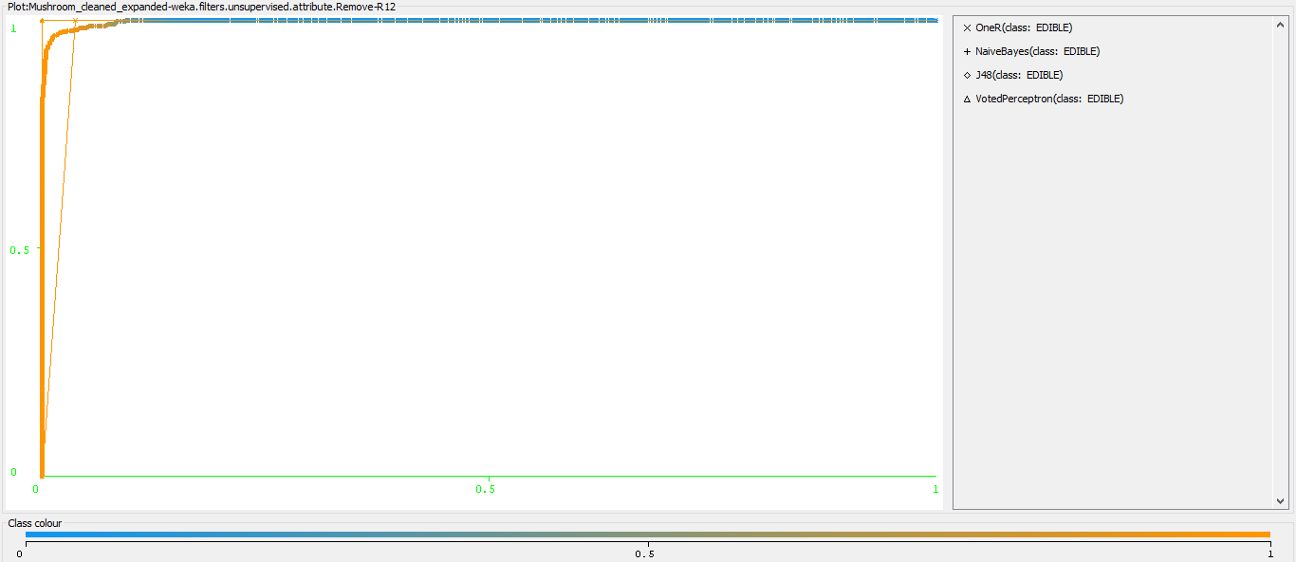
ROC CURVE For Edible

Slide 31
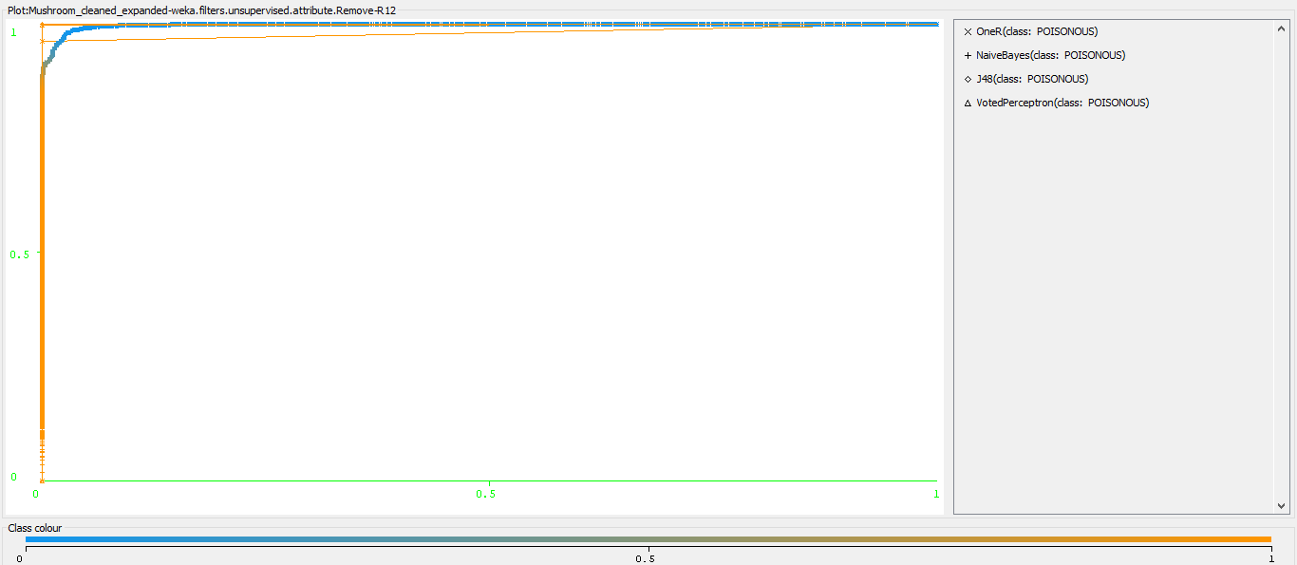
ROC CURVE For Poisonous

Slide 32
CONCLUSION
Given a set of mushrooms , classifying them as edible or poisonous using various algorithms in Weka was the primary objective. So, we have to identify an algorithm with the highest accuracy and lowest variance.
Algorithms like J48, Voted perceptron and One R have high accuracy, but the accuracy vary significantly when compared with each experiment sample (High variance).
Naïve Bayes was observed to have high accuracy and low variance when compared with each experiment after feature selection.
Based on these results we can conclude that Naïve Bayes algorithm is suitable for Mushroom classification.

Slide 33

QUESTIONS?

Slide 34


